Slide 1
Neural Networks
Dr. Thompson
March 26, 2013

Slide 2
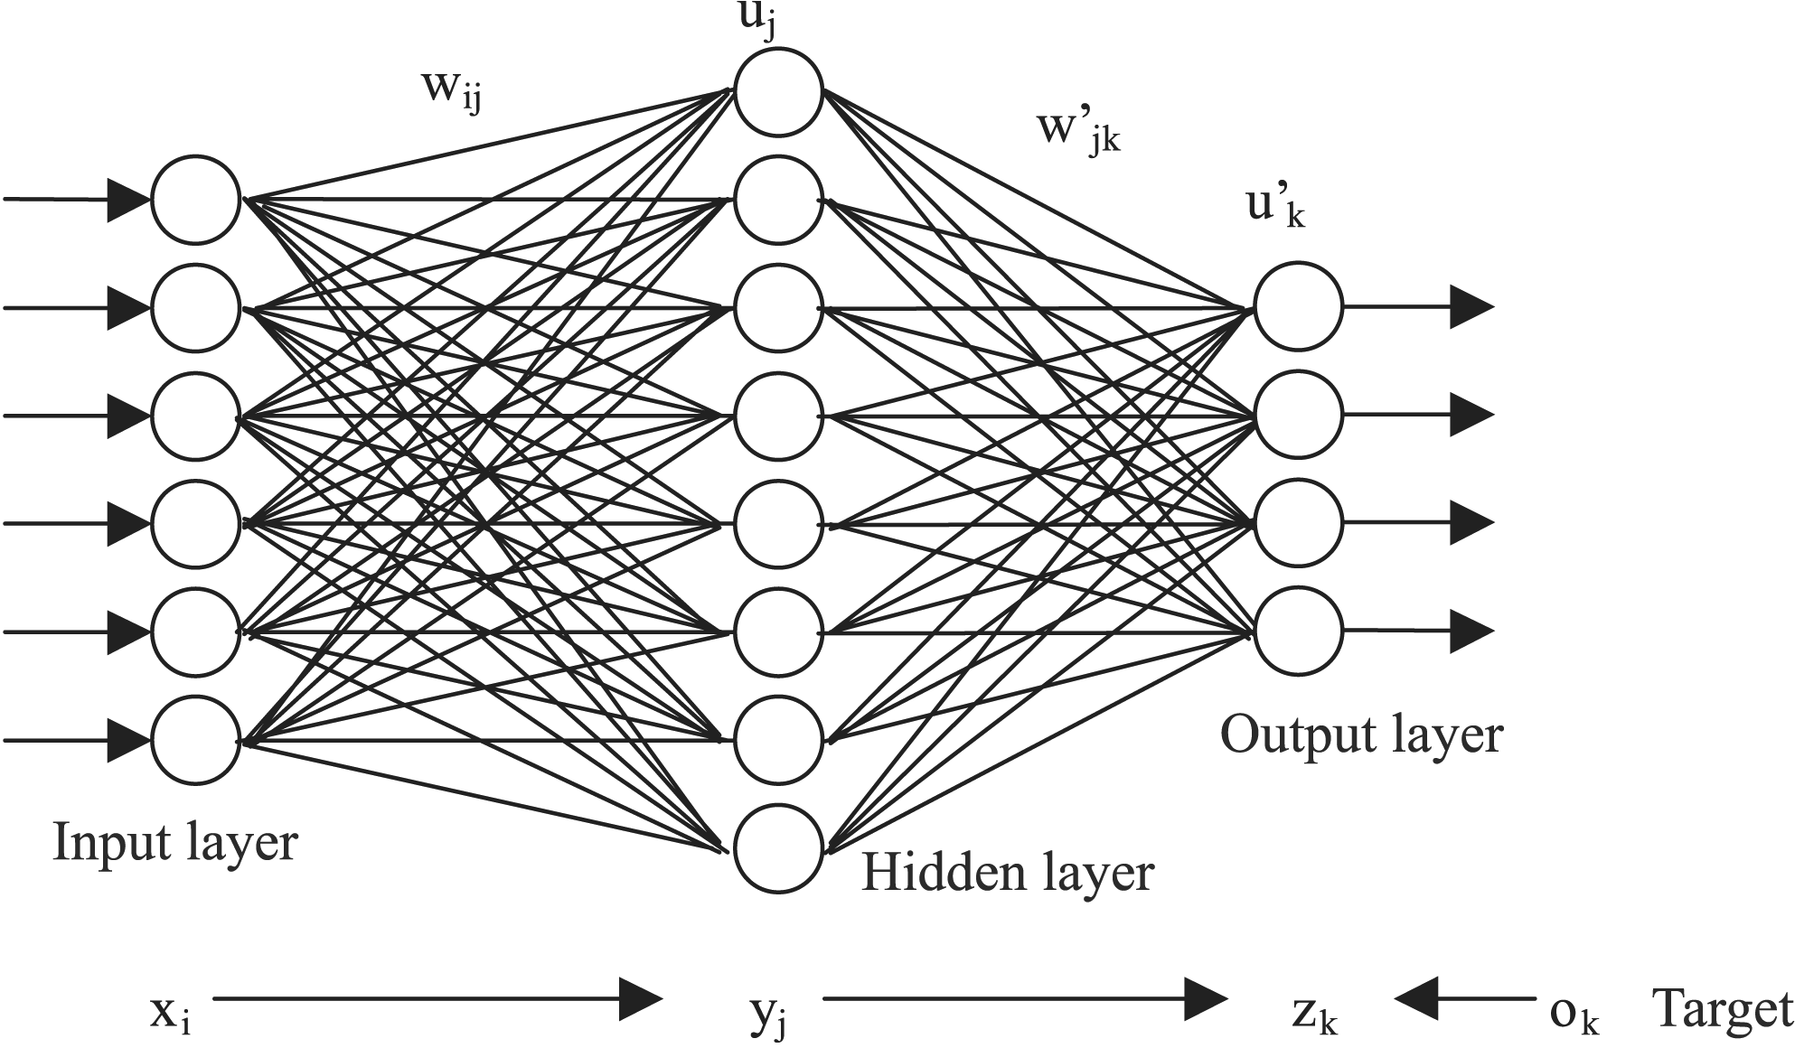
Artificial Neural Network Topology

Slide 3
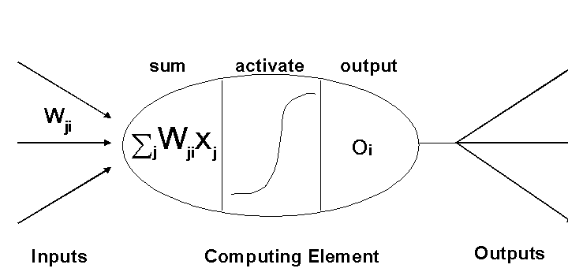
Artificial Neuron Activation

Slide 4
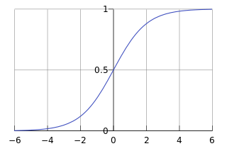
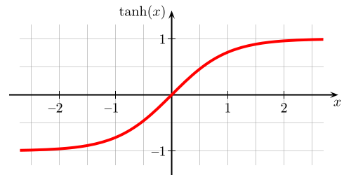
Threshhold Functions
(include graphs)
Linear
Logistic
Hyperbolic Tangent – Sigmoid (*)
Step
Logistic Curve

Slide 5
Network Output
Y = f(WX)
Z = f(W’Y) = f(W’f(WX))

Slide 6
Error Correction
  (Method of Least Squares)
Minimize Total Error = E = Σ (Z-O)² using Partial Differentiation
(Calculus III)

Slide 7
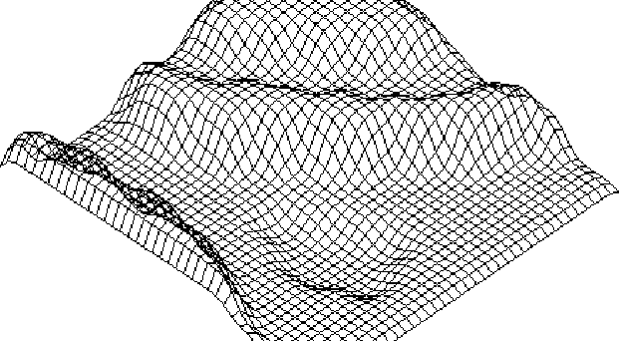
Error Function:
Local & Global Minima

Slide 8
Back Propagation
http://en.wikipedia.org/wiki/Backpropagation

Slide 9
Least Squares Tutorial
Linear Regression
Derive optimum slope and intercept
How do we do Quadratic? Cubic?
Why not nth Degree Polynomial?
Overfitting

Slide 10
Learning & Testing
Matlab Examples
Simple Classes
Thyroid
Breast Cancer

Slide 11
Questions?

